Slide 1
Title
Name or names
RESTRICTED

Slide 2
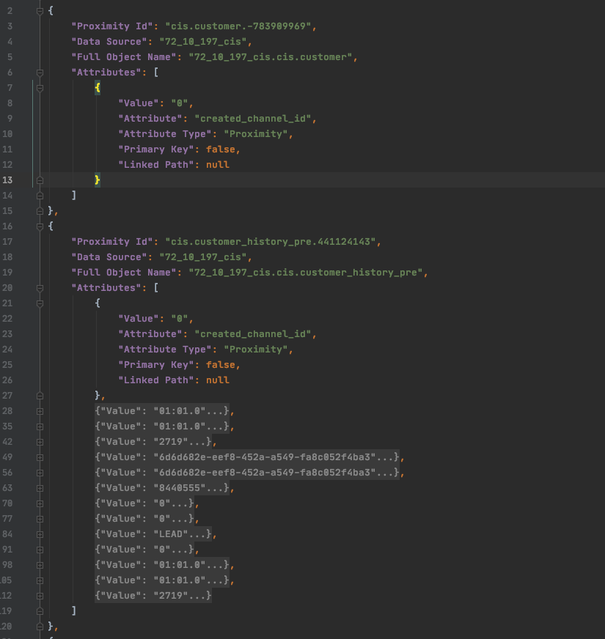
Option 1
A JSON format which each record represent one row in a table and the attributes field represent its columns with their values
Type to enter a caption.
RESTRICTED

Slide 3
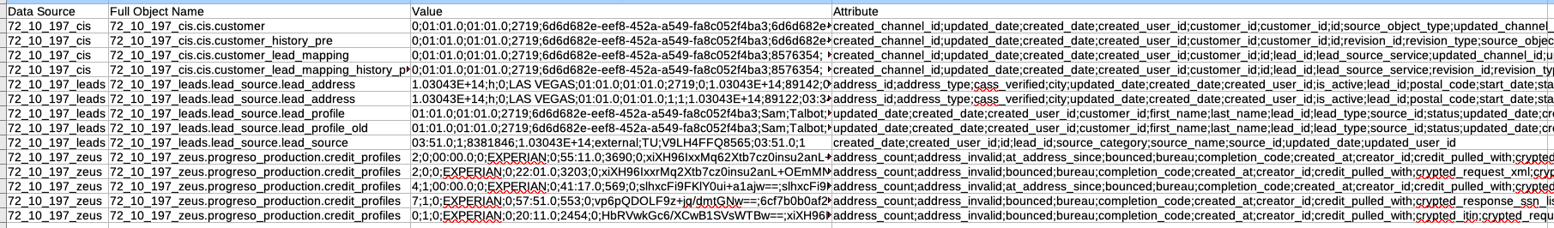
Option 2
A CSV which one row represents a unique record, the column and value names are zipped in two columns where the data is comma semicolon-separated
RESTRICTED

